Slide 1


Title: ZS Case Challenge 2018 Case Study
KRYPTO MOTORS, KOREA
ELECTRA, KRYPTO MOTORS
Akshay Adhana
Aman Mittal
Siddhant Sharma
Report and Analysis
18/07/2020

Slide 2
SCQA
Situation
Launching a new brand Electra by Krypto Motors in the Indian market and plan it’s launch strategy and help set up operations to sustain and grow the business.
Key Question & Answer
What is the Key Question we are solving
Market Value and Opportunities for Electra, Revenue Forecast, Marketing Mix Strategies involving different industries.
Identifying key cities for launch, planning a sustaining and growth strategy, calculating incentives for the company
Dashboard Creation
Complications
Assembling and structuring the data
Mathematical Analysis of the past and current market
Researching on marketing mix strategies
Removing duplicates from the data and creating interactive visuals.

Slide 3
Executive Summary
Executive Summary
Krypto Motors is a Korean-based company with one of the marketing programmes of any automobiles manufacturer is looking to make it’s foray into Indian market
It has now earmarked India as a part of it’s strategic plan for global expansion outside Korea and Japan
Product
In order of rising pollution levels and as a part of greenfield project of government, Krypto Motors launching it’s successful brand name “Electra”.
It is planned to launch Electra in 2021 that posses on “Ergonomic Design Feature”.
Price
The cost and pricing when Electra will come to market is 25Lacs to 30Lacs
Promotion
Combining many different methods of media to reach their potential buyers.
Annual Marketing Budget comprising of INR 10 Million
It will be invested many channels such as Social Media, Print and TV etc.

Slide 4
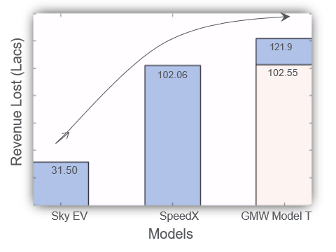
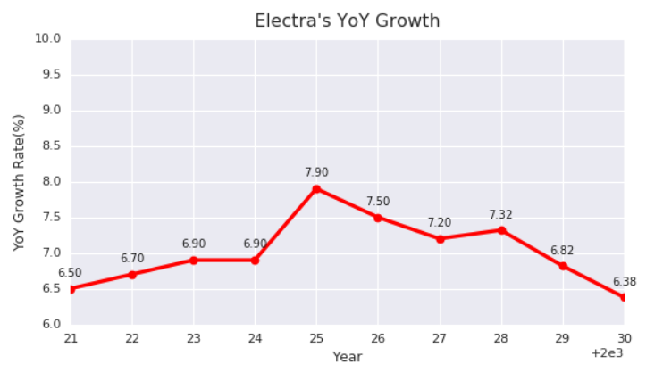
Marketing Returns by Advertisement Channels (Forecast)
Expected Returns (in INR millions)
Notes:
General perception towards EVs is changing and we expect a higher uptake (~1.4) in the average growth from 2025
2021 revenue for Electra starts from 6.5% and grows to 7.9% till 2025.
The market share decreases due to announcement of a new EV company in 2028, but the rate is less compared to Fluent.
Electra’s revenue in 2008 was ~ INR 37.2 million
Notes:
5% revenue is lost by all EV companies
30% revenue lost by Sky EV, SpeedX, GMW Model T (Conventional Cars)
GMW Model T shows an increase in loss by 19.35 lacs after launch of Electra.

Slide 5
Max Return |  | Max Return based on Allocation | If Budget is Allocated | Allocation Weightage | Amount Allocated | Return Expected | ROI
Events |  | 80% | 40% | 25% | 2,492,211.84 | 1,993,769.47 | 68%
Socia Media |  | 75% | 70% | 23% | 2,336,448.60 | 1,752,336.45
TV |  | 60% | 50% | 19% | 1,869,158.88 | 1,121,495.33
Print |  | 71% | 100% | 22% | 2,211,838.01 | 1,570,404.98
Online |  | 35% | 100% | 11% | 1,090,342.68 | 381,619.94
Total |  | 321% | 360%
Max ROI | 68%
Therefore The Max Return achieved by Allocating Budget on Table G
Best Budget can be allocated as
Channels |  | Budget
Events | 25% | 2492211.838
Socia Media | 23% | 2336448.598
TV | 19% | 1869158.879
Print | 22% | 2211838.006
Online | 11% | 1090342.679
With ROI | 68%
b) Maximum Revenue generated
Channels
 | Budget | Return | Total Revenue
Events | 2492211.838 | 1,993,769.47 | 4485981
Socia Media | 2336448.598 | 1,752,336.45 | 4088785
TV | 1869158.879 | 1,121,495.33 | 2990654
Print | 2211838.006 | 1,570,404.98 | 3782243
Online | 1090342.679 | 381,619.94 | 1471963
Total Amount | 10000000 | 6819626.168 | 16819626
The Driving force for maximum return are based on consumption and maximum revenue generated. So Our messages across the channels will be prioritize based on the Age
Factor choices on the following preferences across the channels.
Using Age as base for tailoring our messages across channels will help us cover all segments, specially who are contributing to revenue generation and consumption.
We will tailor are messages with special emphasis on Early Adopters & Commercial users specially on social media, TV and communication channels on priority.

Slide 6
Q1. Analysis & Take away
Section 1: Analysis & Take away
We get insights on the starting revenues, generated soon after the model is launched and plan on the dividends for the work force in advance.
Seeing the market and analysing the competitors we learn about the most sought after price range, i.e. 26 Lacs to 30 Lacs
The data from the second part gives outlooks on the long term estimated revenue which may be collected by comparing our growth rate with other competitors. Revenue for Electra at the end of 2030 is 1.2 billion INR
Maximum Users | C-Suites
Max Consumption | Early Adopters
Max Revenue | Commercial Use
Max Channel Used | Social Media

